Slide 1
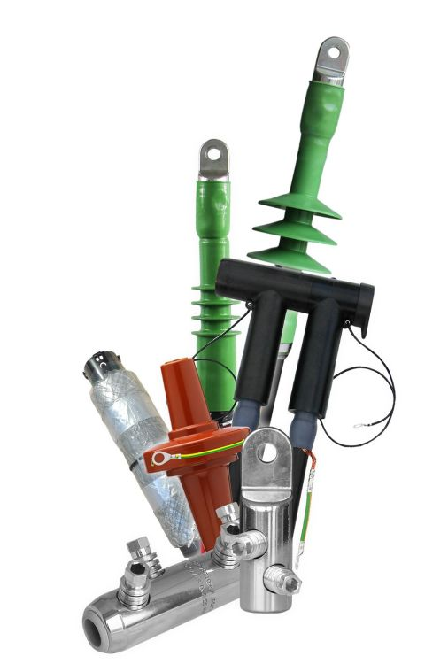
New Cable Adaptor CA0
EUROMOLD®
Separable connectors
  November 28, 2019

Slide 2
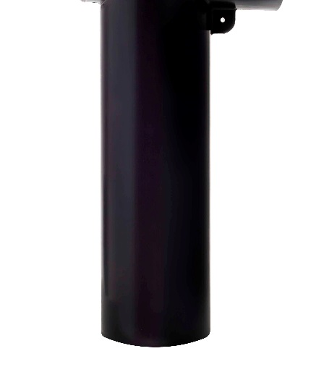

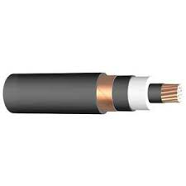
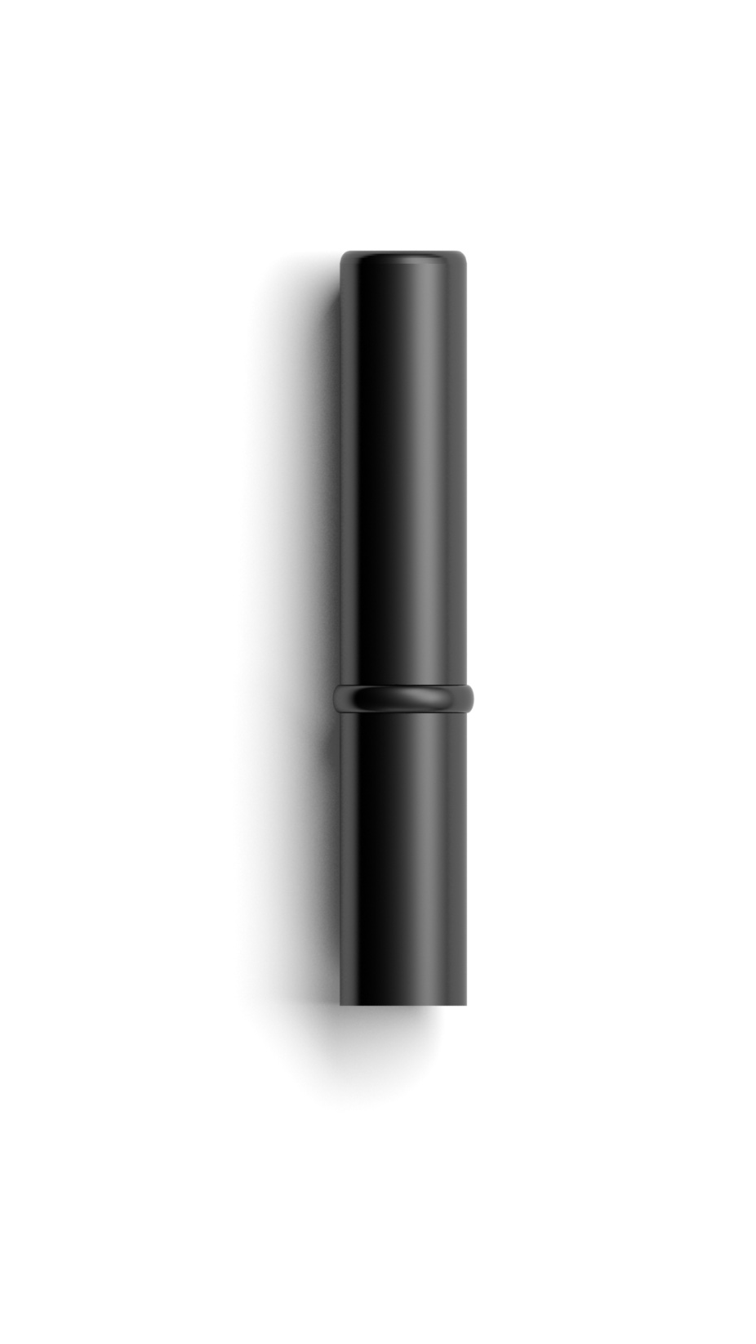
What is a cable adaptor
Adapt the cable to the connector
Different diameters >>> different inner diameters >>> fixed inner diameter
fixed outer diameter
Cable CA Connector
Part of the field control system
Part of the water sealing system

Slide 3
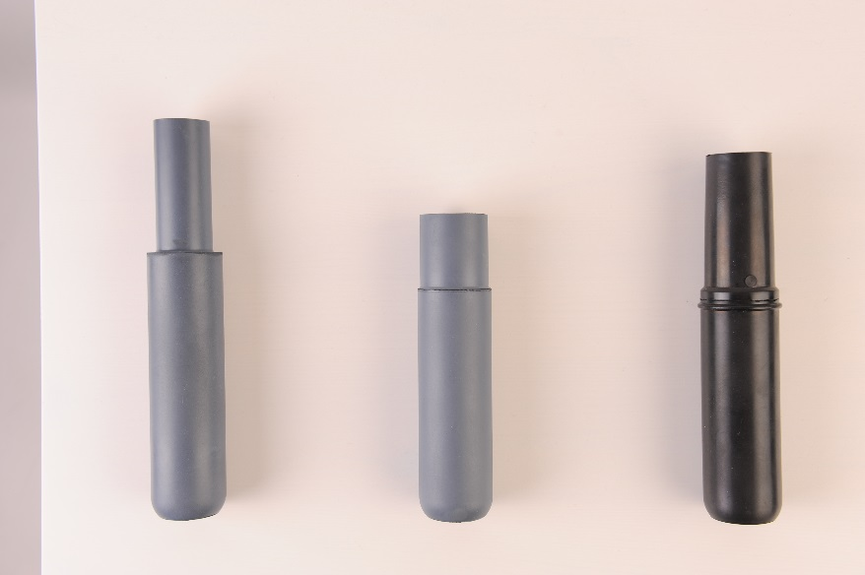
Objective & concept
Aquired know-how – can we use the research done for the 200LR on other products
Capacity increase – new machines and moulds
Eco friendly – no more metal oxides
Complexity reduction – reduce the number of models

Slide 4
Complexity Reduction
This project has allowed us to reduce the number of different models from 13 to 5.
Existing models
411CA-11 430CA-11
411CA-15 430CA-16
411CA-19 430CA-18
411CA-22 430CA-21
411CA-25 430CA-22
411CA-27 430CA-27
430CA-30
New models
CA0-11
CA0-15
CA0-18
CA0-21
CA0-27

Slide 5
Name: CA0-18
CA: Cable Adapter
0: Refers to the size of the connector (external diameter of CA):
    0: for 480TB (ϕe: 39 mm)
    4: for 484TB (ϕe: 54.5 mm)(planned 2021)
    9: for 489TB (ϕe: 74 mm)(not planned)
-18: Refers to the size of the cable (internal diameter of CA)

Slide 6
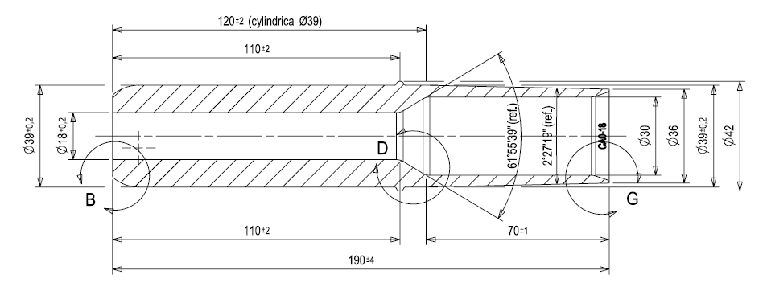
Design
  Material
  Black
  Extra soft EPDM (same as 200CA)
  Length in connector: 110 mm
  for use with 480TB, 430TB, 400LR, 400TB
  Extra long water tightness zone for use with CW, CT, Wiski & AluPe
  Ridge for robotization

Slide 7
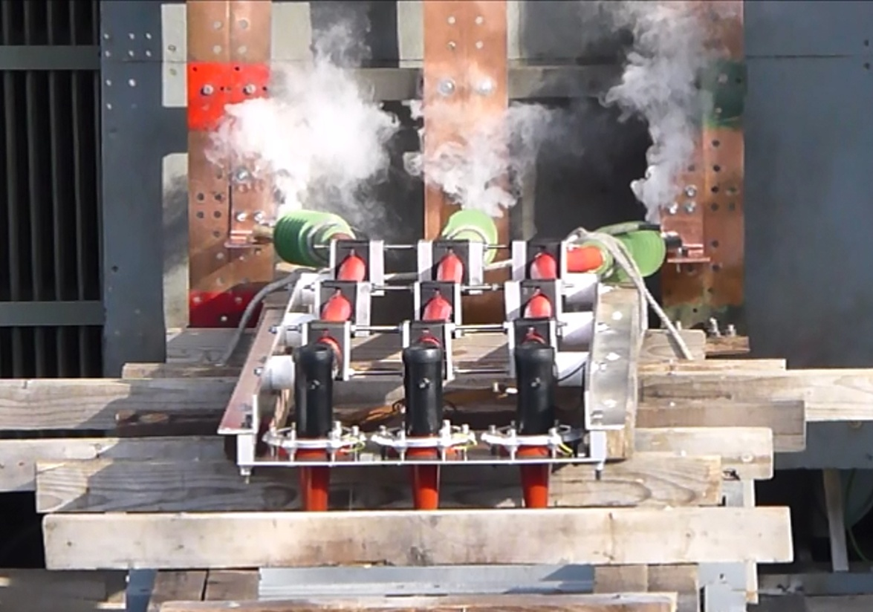
Qualification
Released for: 12, 17,5 and 24 kV.
Upgrade to 36 kV planned for Q3/2020.
Qualified for:
  430TB, 300PB, 480TB and 800PB.
  following HD629 D1 and D2.
  all test reports are available.
  running for 400LR and 400TB.

Slide 8
Ranges
CA0 | 430CA | 411CA
CA0-11 12.0-19.0 mm | 430CA-11 12.0-17.5 mm | 411CA-11 12.0-17.5 mm
CA0-15 16.0-26.5 mm | 430CA-16 17.0-23.5 mm | 411CA-15 16.0-22.0 mm
CA0-18 19.0-32.6 mm | 430CA-18 19.0-32.6 mm | 411CA-19 20.0-26.5 mm
CA0-21 22.0-34.6 mm | 430CA-21 22.0-33.0 mm | 411CA-22 23.5-31.0 mm
 | 430CA-22 23.5-32.0 mm | 411CA-25 26.5-32.5 mm
CA0-27 28.5-37.5 mm | 430CA-27 28.5-37.5 mm | 411CA-27 28.5-37.5 mm

Slide 9
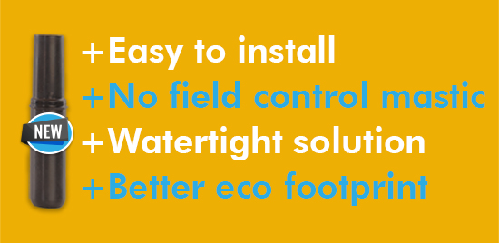
Advantages
Easy to install: improved elasticity and reduced hardness.
No field control mastic: even when installed on pealable cable.
Watertight solution: due to a longer cable jacket cover,
Eco design: no more metal oxides.

Slide 10
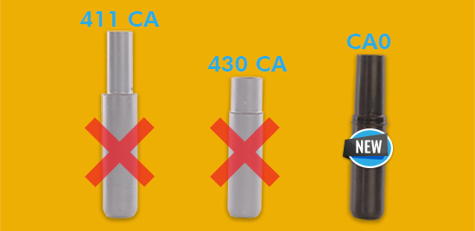
Transition
Installation sheet: translations.
Catalogue pages: same numbers or new kits.
When: start in December; old version fade out in 12 months.

Slide 11
Nexans Power Accessories
Nexans Network Solutions N.V. - Div. EUROMOLD
ZUID III - Industrielaan 12
9320 Erembodegem
Belgium
Phone: +32 (0)53 85 02 11
sales.euromold@nexans.com
www.nexans.com/power_accessories

